Slide 1
Setting a Course for a Sustainable Landscape

Slide 2
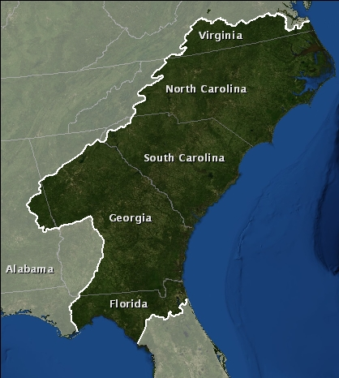
What does the SALCC do?
Mission: Create a shared blueprint for landscape conservation actions that sustain natural and cultural resources

Slide 3
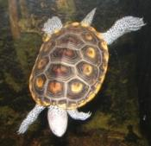
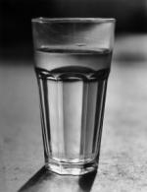
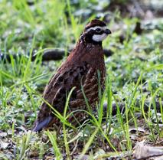
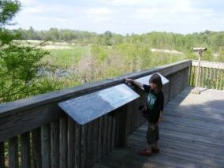
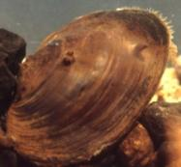
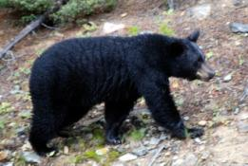
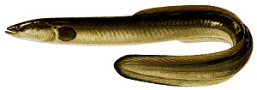
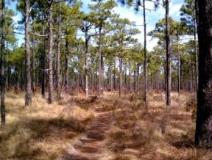
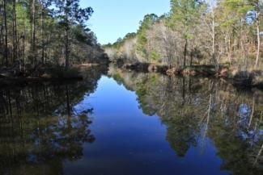
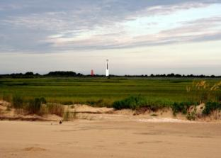
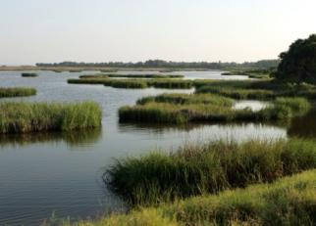
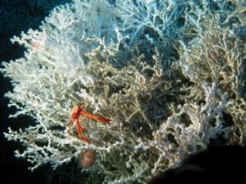
Indicators and Targets: Why do they matter?
The blueprint will need to paint a compelling picture of the future of the South Atlantic region

Slide 4
Indicators and Targets: Why do they matter?
The blueprint will need to paint a compelling picture of the future of the South Atlantic region
It needs to represent why we care about the ecosystems of the area

Slide 5
Developing the process

Slide 6
Natural Resource Indicators Process Team
Purpose: To develop the process for building off existing efforts to set indicators and measurable targets for SALCC natural resource goals

Slide 7
Who was on the team?
Jon Ambrose GA DNR / SWAP
Shannon Deaton NC WRC / SWAP
John Stanton FWS / ACJV
Linda Pearsall NC DENR / Natural Heritage
Robert Boyles SC DNR - Marine division
Pete Campbell FWS / ENCSEVA
Dean Carpenter NC DENR / APNEP
Maria Whitehead TNC

Slide 8
Who was on the team?
Mary Long USFS
Tim Pinion NPS
Wilson Laney FWS/ Numerous partnerships
Roger Pugliese SAFMC
Reggie Thackston GA DNR / Private lands
Breck Carmichael SC DNR
Rick Durbrow EPA
Vic Engel USGS / Everglades restoration
Jimmy Evans GA DNR

Slide 9
Indicator process flowchart (Sept - Nov)
SALCC community
Web community
Raleigh workshop
Savannah workshop
Web community
Indicator team
Draft process from indicator team
Revised process
Steering committee
Process approved
September October November

Slide 10
Definitions

Slide 11
Terms
Goal: Desired conservation outcome that is difficult to measure Indicator: A metric that is designed to inform us easily and quickly about the conditions of a system Target: A measurable endpoint for an indicator

Slide 12
Indicator framework

Slide 13
Broad goals
Natural resources
Integrity of ecological
systems
Viability of key species
Cultural resources
Sites
Objects
Biotic cultural resources
Socioeconomic resources
Recreation
Human health
Economy

Slide 14
Ecosystems (Natural Resources)
Marine
Estuarine
Beach and dunes
Forested wetlands
Tidal and nontidal freshwater marshes (managed and unmanaged)
Freshwater aquatic (streams, lakes, ponds)
Scrub-shrub (includes cliffs and outcrops)
Pine woodlands, savannas, and prairies (includes longleaf, loblolly, and slash systems)
Upland hardwood forests
Landscapes (Habitat aggregate)
Waterscapes (Habitat aggregate)

Slide 15
Crosswalk of partners indicators to framework

Slide 16
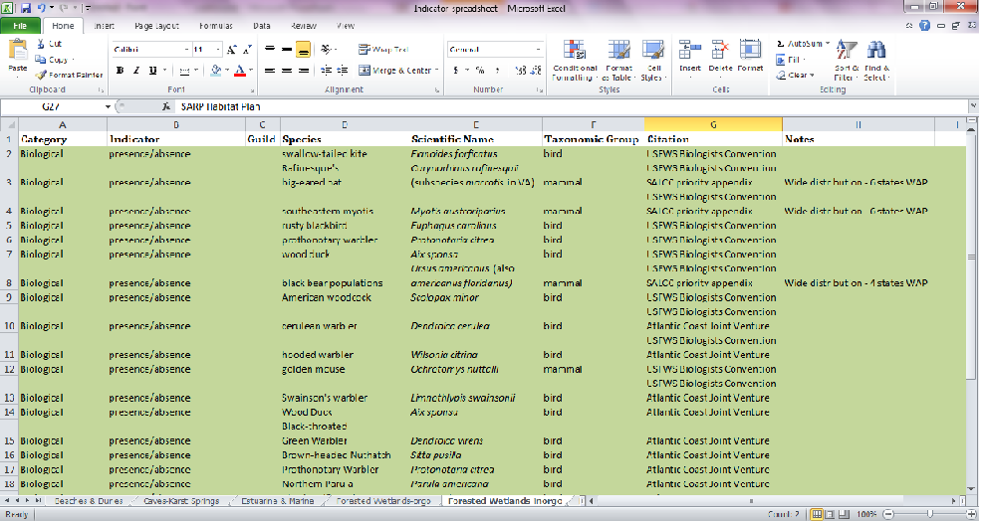
Synthesis of existing plans
Compile spreadsheet of existing indicators for each habitat type
Build off existing work to minimize redundancy

Slide 17
Sources
Sources
SWAPs
Atlantic Coast Joint Venture
Albemarle-Pamlico National Estuary Program: 2012 Ecosystem Assessment
Southeast Aquatic Resources Partnership: Southeast Aquatic Habitat Plan
USFWS Southeast Biologist Conference
NOAA Southeast and Caribbean Regional Team (SECART)
NPS Inventory and Monitoring Program
National Bobwhite Conservation Initiative 2.0
Fishery Management Plans
USFS Management Indicator Species
America’s Longleaf Conservation Plan
National Fish and Wildlife Foundation Longleaf Stewardship Fund
ENC/SEVA Strategic Plan

Slide 18
Selection criteria

Slide 19
Criteria for indicator selection
Can be a species, collection of species, or habitat metric (biotic or abiotic)
~ 3 indicators per habitat

Slide 20
Criteria for indicator selection
Ecological criteria
Ability to represent a variety of organisms and ecological attributes within that habitat type throughout a major portion of the LCC
Sensitivity to big landscape threats in the region while having predictable and limited sensitivity to other factors such as natural variations or disturbances (i.e., high signal to noise ratio)
Practical criteria
Ease of monitoring with existing programs and resources
Amount of overlap with existing plans and processes
Ability to model indicator based on current data or existing projects

Slide 21
Criteria for indicator selection
Social criteria
Ability to resonate with the American public
Ability to link with an economic value
Level of interest by public land or water managers
Level of interest by private land or water managers

Slide 22
Criteria for target selection
Amount of overlap with existing plans and processes
Is the target achievable?
Is there enough capacity to monitor the target?
[In the future] Amount of overlap with cultural and socioeconomic goals

Slide 23
Selection process

Slide 24
Simple timeline

Slide 25
Simple timeline
Nov 2012: Form two teams to select and revise indicators
Selection team role
Revision team role

Slide 26
Simple timeline
Dec 2012: ID key indicators not in crosswalk of partner indicators
Selection team gathers input and makes decision
Revisions team captures lessons learned

Slide 27
Simple timeline
Jan 2013: Key audiences score potential SALCC indicators
Selection team gathers input
Revisions team captures lessons learned

Slide 28
Simple timeline
Feb 2013: Recommendations from selection and revisions team
Selection and revisions team meet to make final recommendations

Slide 29
Simple timeline
Mar 2013: Steering committee decision on indicators and process to test
and revise
Decision on recommendations from selection and revisions team

Slide 30
Simple timeline
Spring 2013?: Assessment of indicator function
Begin implementation of revision process

Slide 31
Implementing the process

Slide 32
Indicator selection team members
Joe DeVivo NPS
Tim Pinion NPS
Brian Watson VA DGIF
Beth Stys FL FWC
Wilson Laney FWS
John Stanton FWS
Maria Whitehead TNC
David Whitaker SC DNR
Mark Scott SC DNR
Breck Carmichael SC DNR
Billy Dukes SC DNR
Reggie Thackston GA DNR
Jan MacKinnon GA DNR
Jimmy Evans GA DNR
Jon Ambrose GA DNR
Duke Rankin USFS
Roger Pugliese SAFMC
Ryan Heise NCWRC
Scott Anderson NCWRC
Lisa Perras Gordon EPA

Slide 33
Indicator review
Detailed input from 235 experts in marine, freshwater, and terrestrial resources in the South Atlantic region and 9 experts representing all 5 adjacent LCCs
197 online reviews
Feedback from all adjacent LCCs
Input from regional partnerships
Phone interviews with 18 local experts
Integration of feedback of final recommendations by 20 member Indicator Team

Slide 34
The approach to expert review
A representative sample of reviewers get interviews
Everyone else gets the online review form

Slide 35
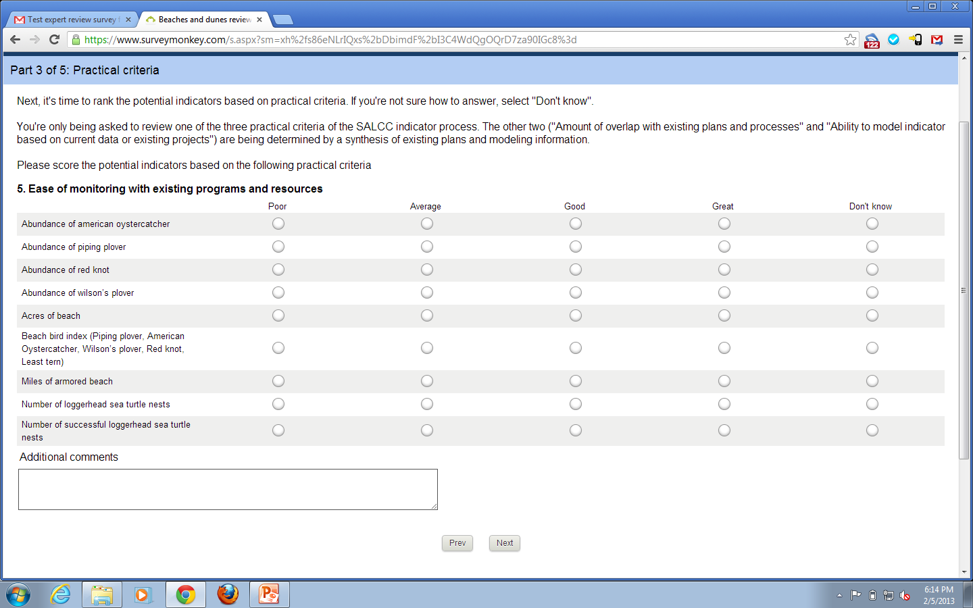

Slide 36
Indicator revision team members
Joe DeVivo NPS
Tim Pinion NPS
Dave Steffen VA DGIF
Brian Branciforte FL FWC
Laurel Barnhill FWS
Greg Moyer FWS
Jan MacKinnon GA DNR
Chris Goudreau NCWRC

Slide 37
March 2013 Steering Committee meeting
Natural resource indicators and targets approved
Process for testing and revising indicators and targets approved
More info: http://www.southatlanticlcc.org/page/indicators

Slide 38
Next steps and lessons learned

Slide 39
Next steps for indicators
Natural resource indicators testing and revision process has begun
Report card on past, current, and future state of indicators (South Atlantic 2050)
South Atlantic Conservation Blueprint 1.0

Slide 40
What worked well
Combination of individual interviews and web surveys
Broad partnership discussion to decide on the process
Limited time needed by indicator team members (two 2hr web meetings + a two day in person meeting)
Idea of developing a testing/revision process early

Slide 41
What didn’t work well
An early focus on only species as indicators
Early thinking that we wouldn’t need workshops to discuss the process

